Slide 1
Faster!
Profiling CUDA applications
Supervisor: WONG Weng Fai
Student: Shen Zongyi

Slide 2
Want to profile a CUDA application?
Nsight
Good, but not so good
Nvprof
Complex dynamic behavior!
Threads in different blocks run asynchronously!
These tools can only capture the overall behavior of an application or kernel.
Any other choice?

Slide 3
cycle-level
GPGPU-Sim
cycle-level
Too slow
software based (can fit different architectures and applications)
high accuracy
Using software to simulate hardware
will of course lead to slow speed.
support CUDA

Slide 4
GPGPU-Sim
nvprof
We want to combine the advantages of
these two methods and avoid their
disadvantages as much as possible.

Slide 5
work flow
Separate the power model (GPUWattch) from GPGPU-Sim
Let the power model generate the final power report based on the performance counters stored in file.
Use nvprof to generate power metrics of CUDA applications
Transform the power metrics from nvprof to the performance counters which can satisfy GPGPU-Sim’s power model
Change configuration files to make our power model more realistic

Slide 6
Separate the power model from GPGPU-Sim
GPGPU-Sim
GPUWattch
GPUWattch
file manually generated
performance counters
performance counters
power report
power report

Slide 7
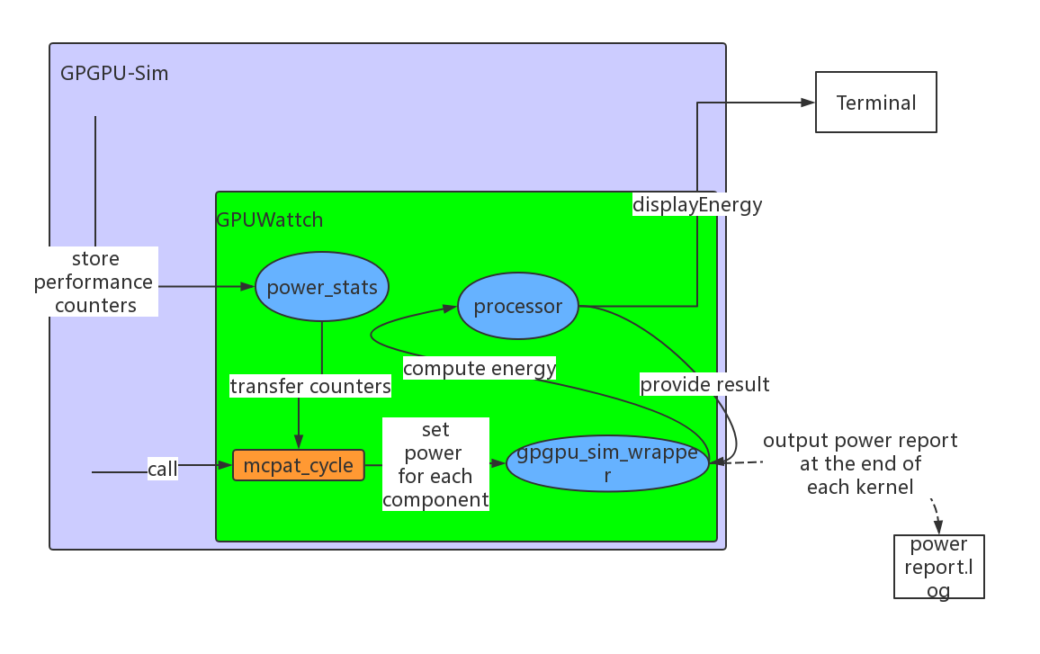
How GPGPU-Sim generate a power report

Slide 8
The most important function mcpat_cycle
Every sample period (500 cycles by default), this function will be activated and calculate
the power for each component. The results will be stored.
The function to generate the power gpgpu_sim_wrapper::print_power_kernel_stats()
At the end of each kernel, this function will be called and generate the power report
based on the data stored by function mcpat_cycle.
There are other useful functions and variables GPUWattch uses…
How can we use these functions in our main code?

Slide 9
First, write a main.cc to use the functions with the same logic as GPGPU-Sim uses.
Make sure if we can use these functions, we will generate a power report.
Third, find a set of object files that
contains all the functions/variables we need
do not rely on other object files or libraries
Second, find a set of
.h files that define the functions and variables we use.
And, include them in our main.cc.
Design the compile command,
include all the .h files in
the –I option and all the .o files

Slide 10
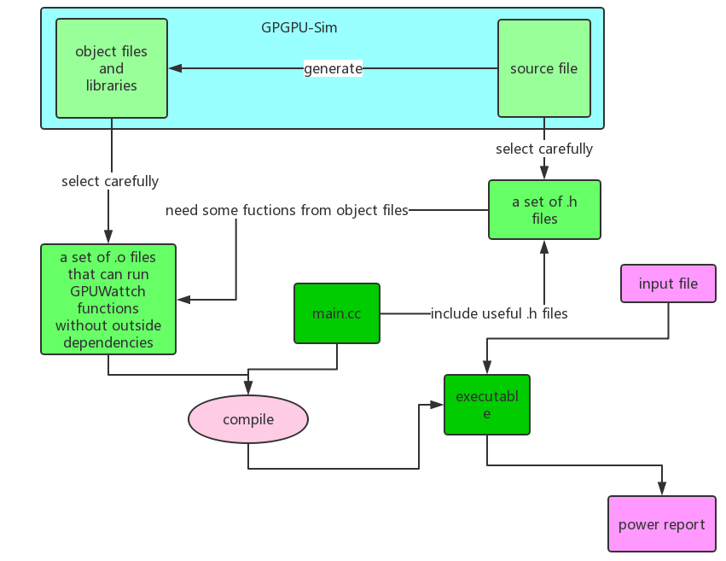
Work flow

Slide 11
2. Let the power model generate the final power report based on the performance counters stored in file.
First, we want to know the format of all performance counters and sample values.
We modified the original mcpat_cycle function to let it output the performance counters during each cycle.
This is the sample values for all performance counters for one single cycle.
0 500 18 3 15 4 0 9 512 192 256 7 0 0 0 0 0 0 3 1 0 0 0 0 0 0 14.976000 0.000667 0 0 0 48 2000 264 0.000000 0.000000 0.000000 0.000000
Every performance counter is converted to a digit ( double or integer ).
Every period, GPUWattch will calculate the power for each component based on these data.
If the application exists for N cycles, then the file will have N/500 lines.
So if we give GPUWattch a file that contains all these values and modify the function mcpat_cycle to let it read in data from file, GPUWattch will generate a power report that is the same as the one generated by simulating all the program

Slide 12
But where is the data to feed GPUWattch?
Now we can do this!
GPUWattch
GPGPU-Sim
GPUWattch
file storing performance counters
performance counters
performance counters
power report
This is not good. We need another way to generate the data.

Slide 13
3. Use nvprof to generate power metrics of CUDA applications
What will nvprof give us?
It can only give us the metrics of each kernel…
Device | Kernel | Invocations | Metric Name | Metric Description | Avg
TITAN V (0) | executeThirdLayer(float*, float*, float*) | 1 | inst_per_warp | Instructions per warp | 10093.48
What we want is the metrics for each sampling period ( like 500 cycles) ,
but what we have is the metrics for each kernel.

Slide 14
Luckily, if we see more about how the power is calculated…
GPGPU-Sim set a constant for each operation, and the calculation is the number of each type of
operation multiples their according constant.
In each sampling period:
$component^{′}s power=constant ∗(number$ of operations)
This is linear!
We can transfer the performance counters for each kernel to GPUWattch to calculate!
This means that we view this kernel only has one sampling period to finish.
OK, we can transfer the data now… Wait! the metrics from nvprof are not well matched with GPUWattch’s performance counters!

Slide 15
4. Transform the power metrics from nvprof to the performance counters which can satisfy GPGPU-Sim’s power model
The performance counters can be divided into 3 categories…
can be found directly in nvprof’s metrics
Like integer operations, this is included in nvprof’s output
This is good!
can not be found directly, but can be derived from nvprof’s metrics
Like fp operations, this in nvprof is divided into 3 metrics: fp32, fp64, fp16
This is still OK!
3. can neither be found directly or derived…
Like idle cores, nvprof does not offer any information about this…
This is too sad!

Slide 16
To deal with those “missing” performance counters, we have to estimate them as correct as possible

